Slide 1


EVALUATION FRAMEWORKS FOR AI-GENERATED VETERINARY MEDICAL RECORD SUMMARIES
Tyler Poore¹, Aleena Shabbir¹, Christopher J Pinard^{1,2,3,4}, Andrew Lagree¹, Kuan-Chuen Wu¹
ANI.ML Research, ANI.ML Health Inc., Toronto ON Canada
Department of Clinical Studies, University of Guelph, Guelph ON Canada
Toronto Animal Cancer Centre, Toronto, ON Canada
Centre for Responsible & Ethical Artificial Intelligence (CARE-AI), University of Guelph, Guelph ON Canada
github.com/pooret-animl/vet-summary-eval-framework

Slide 2
CONFLICTS OF INTEREST
All members of our team operate ANI.ML Health, a company developing AI-based products for veterinary teams with our research arm producing publication-based research
C. Pinard is funded by the OVC Pet Trust and American Kennel Club for AI-related research

Slide 3

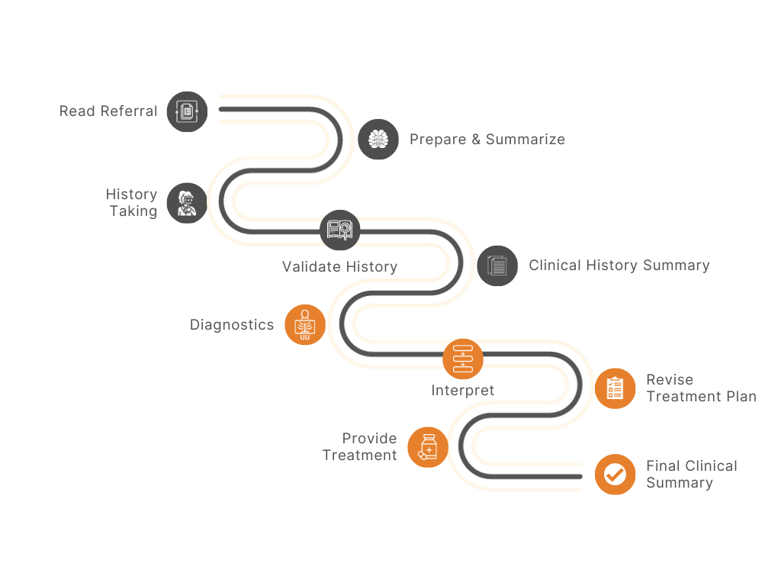
MODERN-DAY CLINICS
Average physician’s visit is 18 minutes (no studies in veterinary medicine)
Internal study of 30 specialists
1-4 hours per patient spent on documentation
Medical scribes have entered the workforce
No validation studies in veterinary medicine
Conflicting results in human medicine
“Perceived time-value”
Data is still shared by stagnant systems (fax, email)

Slide 4
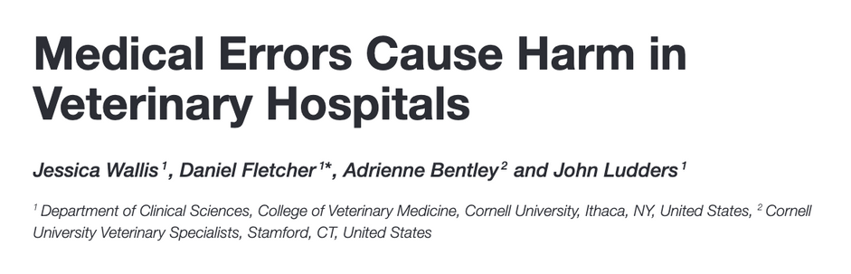

MEDICAL ERRORS
Human:
Errors reported in up to 20% of the notes
Considered “serious” consequence
Veterinary:
Communication errors resulting in ineffective case transfer in 32%
Internal Study (unpublished)
22% of cases
AI tool added information that was not available in clinical records

Slide 5



RESEARCH OBJECTIVES
AI
vs

Slide 6
GOALS
Develop a structured evaluation framework for veterinary summaries
Validate the framework by assessing AI and human-generated summaries
Compare performance: various AI models vs. practicing veterinarians vs. framework implementation (Hachiko)
Identify strengths, weaknesses, and patterns across different summarization approaches

Slide 7
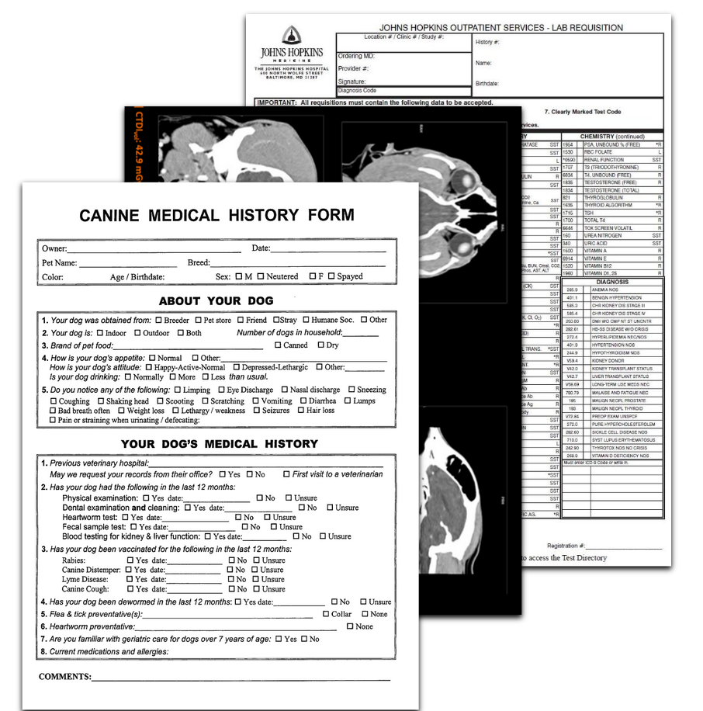
DATASET
41 clinical veterinary records
10 to 261 pages in length
Pairwise comparison
Clinician-written summary
AI-generated summary
Primarily of oncology records (5 internal medicine)

Slide 8
TRADITIONAL-BASED EVALUATION METRICS
Average Metric | Value
Jaccard Similarity | 0.225
ROUGE-1 | 0.330
ROUGE-2 | 0.103
ROUGE-L | 0.187
Semantic Similarity | 0.826

Slide 9
TRADITIONAL-BASED EVALUATION METRICS
Average Metric | Value
Jaccard Similarity | 0.225
ROUGE-1 | 0.330
ROUGE-2 | 0.103
ROUGE-L | 0.187
Semantic Similarity | 0.826
BUT IT DOESN’T REALLY REPRESENT WHAT’S GOING ON

Slide 10




METHODOLOGY
GENERATED SUMMARIES
EVALUATOR AGENT PIPELINE
SCORES, NLP CORRELATIVE
ANALYTICS
Notes:
- Take original dataset
- Multiple sources of summary generation: clinicians, GPT-4o, Claude-3.5-Sonnet, Gemini-2.0
- Evaluation System for Summary Generation: using LLMs to grade the summaries based on grading design and proposed evaluation criteria seen prior
- Testing the performance of all summaries and their grades earned with statistical methods, such as ANOVA, NLP and correlation analysis

Slide 11
LLM GRADING FRAMEWORK DETAILS
MODEL DETAILS:
MODEL_NAME = 'GEMINI-2.5-PRO-PREVIEW-03-25', THINKING_BUDGET = 16,384 , TEMPERATURE= 0.1
Grading Criteria | Weight | Description
Factual Accuracy | 2.5x | Consistency and correctness
Clinical Relevance | 1.5x | Focus on clinical information
Completeness | 1.2x | Inclusion of critical information
Chronological Ordering | 1.0x | Correctness of the timeline
Organization | 0.8x | Clarity, structure, and readability

Slide 12
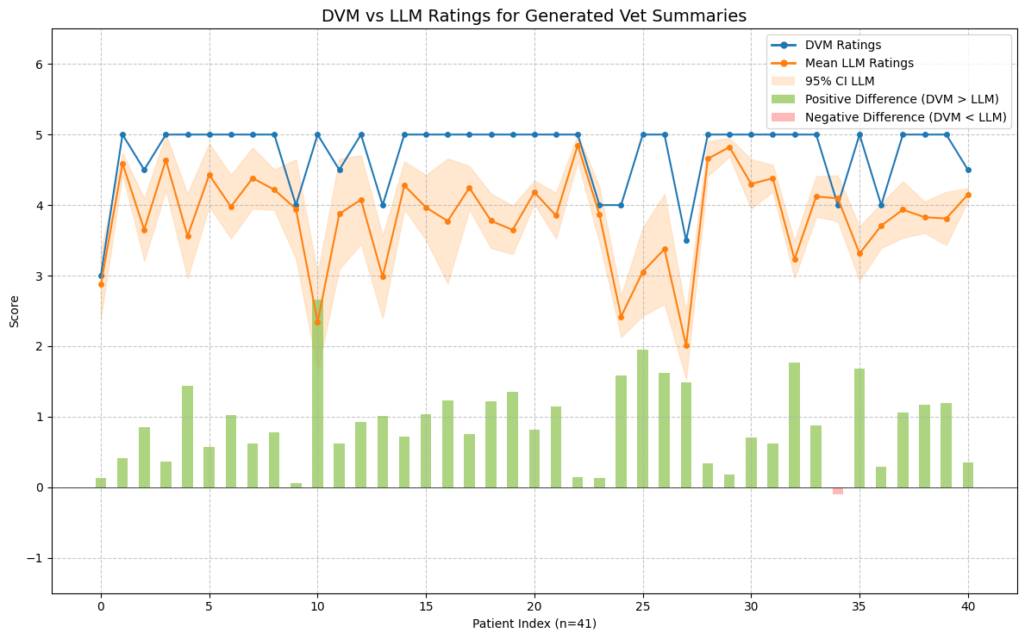
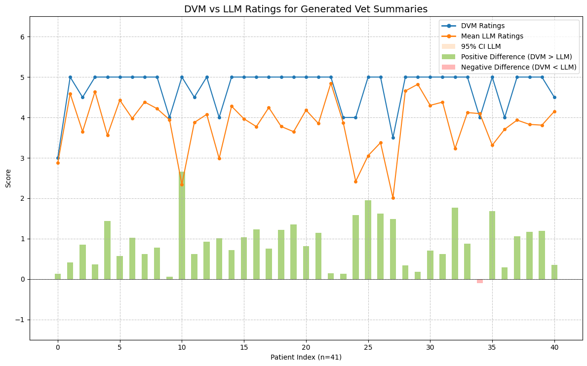
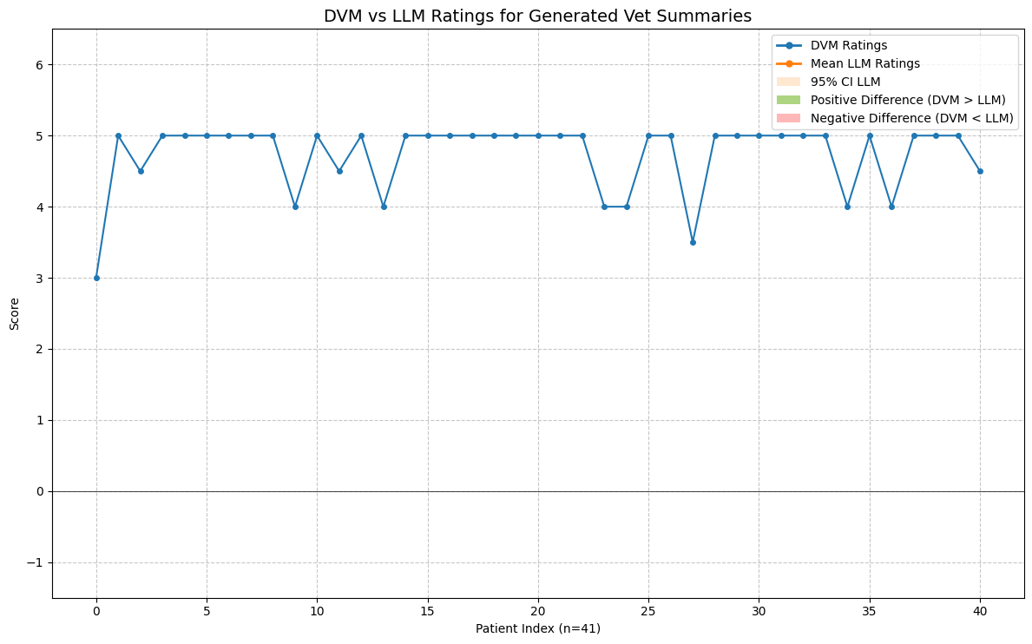
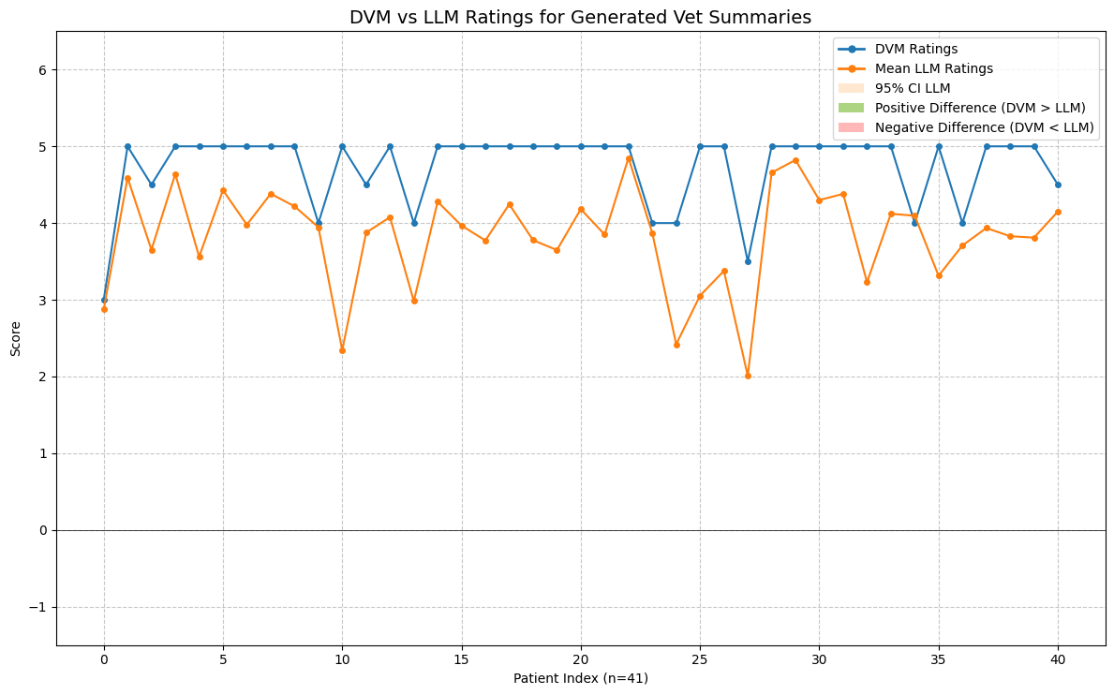
EXPERT GRADING COMPARIONS
Metric | Value | p-value
Mean DVM Rating | 4.735 | n/a
Mean LLM Rating | 3.830 | n/a
Pearson | 0.5030 | 0.0008
Spearman | 0.3967 | 0.0102
Pearson (DVM rating < 5) | 0.6028 | 0.0497
Notes:
Interpretation:
- Moderate positive correlation
- High agreement on co-decreases (critical areas)

Slide 13
GENERATED SUMMARY SCORE FOR PATIENT INDEX 10
DVM SCORE = 5.0
“Excellent summary, I have no additional comments.”
LLM WEIGHTED SCORE = 2.83
"The summary successfully identifies the primary reason for referral (suspected lung mass) and includes relevant chronic conditions like UTIs and otitis. The organization into logical sections is commendable. However, the summary suffers from significant factual inaccuracies, most critically the incorrect date (March 14, 2024 instead of Nov 11, 2024) for the presentation of the cough and subsequent workup. This error fundamentally misrepresents the timeline of the main clinical problem. Other inaccuracies in dates, patient status during follow-up, medication dosage, and listed diagnostics further reduce reliability. Key omissions include episodes of diarrhea and lethargy, and specific findings from the March 2024 exam. While the structure is good, the factual errors require careful correction before this summary can be reliably used."

Slide 14
GENERATED SUMMARY SCORE FOR PATIENT INDEX 35
DVM SCORE = 5.0
“1.8 minutes. LLM picked up conditions I would have missed.”
LLM WEIGHTED SCORE = 2.8
"This summary provides a reasonable overview of PATIENT’s major active health issues, particularly the recent osteosarcoma diagnosis, chronic KCS, cardiac concerns, and tail pyoderma. The organization into sections is helpful. However, its reliability is compromised by several factual inaccuracies (dates, medication status, specific findings) and significant omissions of major past surgical history (MCT removal, TPLOs) and relevant current medication (Gabapentin). The non-chronological presentation of the recent history makes the timeline confusing. Careful review and correction of dates, medication lists (removing finished Clavamox, adding Gabapentin, clarifying KCS meds based on the latest entry), inclusion of the omitted major history points, and chronological ordering of the history section are needed to improve accuracy, completeness, and overall utility for referral purposes."

Slide 15
GENERATED SUMMARY SCORE FOR PATIENT INDEX 27
DVM SCORE = 3.5
“This was a difficult case with very haphazard clinical records. In the defence of the AI, I had some information it did not. However, it did miss (even when a refined prompt was added and a second run) that a new treatment (Lomustine) had been started in December for this patient’s cancer. May be a factor of the disjointment of this clinical record.”
LLM WEIGHTED SCORE = 2.33
"The summary correctly identifies the patient and the diagnosis of Large B-cell Lymphoma, outlining the components of the CHOP protocol and supportive care. It is structured clearly with headings. However, it suffers from significant factual errors (misdated LN measurements, inaccurate current response status, dose discrepancy) and major omissions. Critically, it fails to report the recent switch to a Lomustine rescue protocol indicated in the source text, which is essential for understanding the current clinical situation. It also omits the history of relapse and restarting CHOP, providing a disjointed timeline. These issues severely impact the summary's accuracy, completeness, and clinical utility."

Slide 16
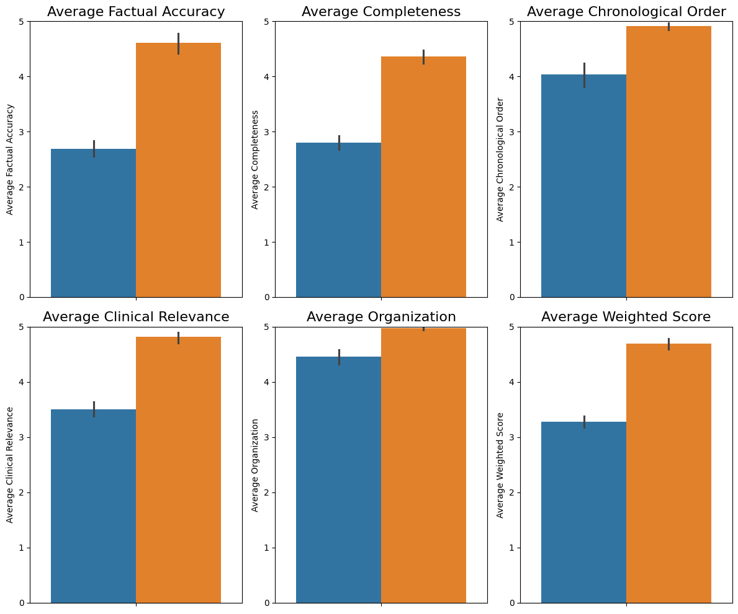
AVERAGE SCORES ACROSS 3 RUNS
Hachiko vs. Doctor of Veterinarian Medicine (DVM) summary evaluations
Hachiko: Consistently outperforms human summaries across all metrics
DVM: Weakest in Factual Accuracy and Completeness. Often due to incorrect dates and missing medications
Notes:
Framework_2 consistently achieved the highest scores across all dimensions.
Clinician-generated summaries scored lowest on most metrics except Organization.

Slide 17
PATIENT INDEX 21 - CLINICAL SUMMARY
LLM FACTUAL ACCURACY SCORE = 2
"The summary contains several significant factual errors when compared to the source text. The patient's breed is listed as Labradoodle, but the source states Labrador Retriever (Page 3) or Lab (Page 1). The summary states lameness began in the left hindlimb, but the source consistently refers to the left forelimb (LF) (e.g., Page 1, Page 10). The presentation date to CLINIC is stated as January 13th, 2025, …
LLM WEIGHTED SCORE = 2.59
”…While the organization is clear, the errors and missing information severely limit its reliability and clinical usefulness as a referral summary. The incorrect limb designation (hindlimb vs. forelimb) is a particularly critical error. Key information like Dr. Hewitt's assessment and recommendations, which directly led to the oncology referral, is absent. The summary needs substantial revision for accuracy and completeness based *only* on the provided source text."

Slide 18
TAKEAWAYS
AI-powered tools are valuable for enhancing the creation and assessment of veterinary medical summaries, potentially alleviating veterinarian workload
A robust evaluation framework was developed and shows:
AI can produce high-quality summaries, often outperforming human-written ones, particularly in factual accuracy and completeness
While LLMs show promise, discrepancies persist between LLM and DVM assessments, with DVMs generally rating summaries higher. Specific instances revealed LLMs missing crucial context or misinterpreting complex/disjointed records.

Slide 19
Thank
You!
github.com/pooret-animl/vet-summary-eval-framework

Slide 20
Sources
[1] Neprash HT, Mulcahy JF, Cross DA, Gaugler JE, Golberstein E, Ganguli I. Association of Primary Care Visit Length With Potentially Inappropriate Prescribing. JAMA Health Forum. 2023;4(3):e230052. doi:10.1001/jamahealthforum.2023.0052
[2] Pozdnyakova A, Laiteerapong N, Volerman A, Feld LD, Wan W, Burnet DL, Lee WW. Impact of Medical Scribes on Physician and Patient Satisfaction in Primary Care. J Gen Intern Med. 2018 Jul;33(7):1109-1115. doi: 10.1007/s11606-018-4434-6. Epub 2018 Apr 26. PMID: 29700790; PMCID: PMC6025675.
[3] Bell SK, Delbanco T, Elmore JG, Fitzgerald PS, Fossa A, Harcourt K, Leveille SG, Payne TH, Stametz RA, Walker J, DesRoches CM. Frequency and Types of Patient-Reported Errors in Electronic Health Record Ambulatory Care Notes. JAMA Netw Open. 2020 Jun 1;3(6):e205867. doi: 10.1001/jamanetworkopen.2020.5867. PMID: 32515797; PMCID: PMC7284300.

Slide 21
Appendix
Model | Factual Accuracy | Completeness | Chronological Order | Clinical Relevance | Organization | Average Score
gpt-4o | 4.316 | 3.395 | 4.289 | 3.895 | 4.624 | 4.106
claude-3-5-sonnet-20240620 | 4.171 | 3.293 | 4.439 | 3.927 | 4.732 | 4.070
claude-3-7-sonnet-20250219 | 4.100 | 3.725 | 4.450 | 4.025 | 4.725 | 4.141
gemini-2.0-flash-001 | 4.237 | 3.895 | 4.237 | 4.263 | 4.579 | 4.222
gemini-2.5-pro-preview-0325 | 4.634 | 4.512 | 4.707 | 4.732 | 4.878 | 4.672

Slide 22
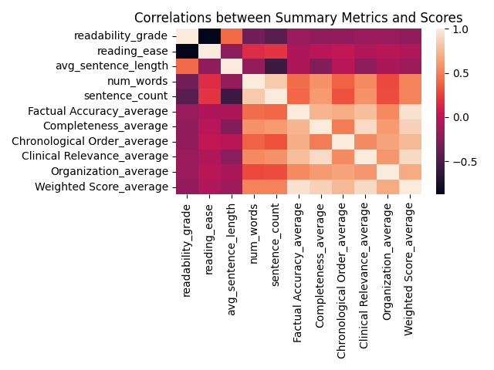
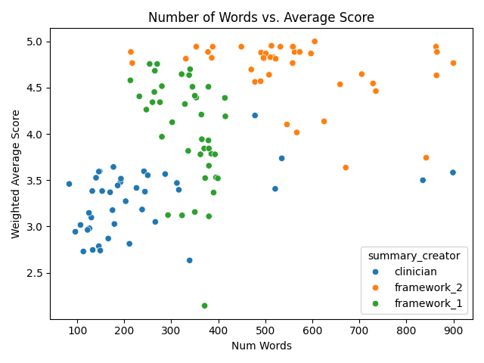
CORRELATION STUDIES
OLS Regression Results
-----------------------------
Dependent Variable: Weighted Score
R-squared: 0.266
F-statistic: 43.89
Prob (F-statistic): 1.01e-09
Intercept: 3.278 (p < 0.001)
num_words: 0.0019 (p < 0.001)

Slide 23
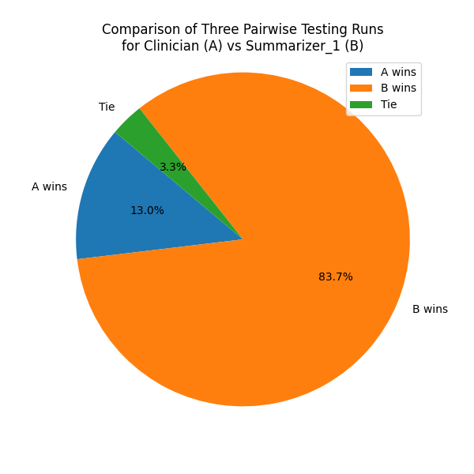
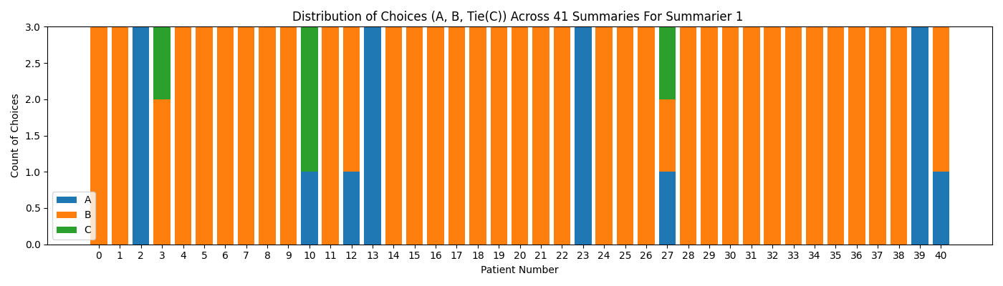
PAIRWISE COMPARISONS ACROSS 3 RUNS
When Summary A was chosen
Preferred for its comprehensive focus on the primary clinical problem.
Captured key elements: diagnostic reasoning, history progression, treatment response.
Despite minor errors, provided a clearer narrative of key events than Summary B.
Compared to A, summary B contained critical factual mistakes and logical inconsistencies.
Summary A excelled in organization and clarity, offering an easy-to-read narrative.
Summary B was often dense, disorganized, and had truncation errors.
Summary A effectively conveyed the essential clinical story with context and history.
When Summary B was chosen
Superior completeness and factual accuracy.
Included more details: comorbidities, prior procedures, medications, lab values, pending plans.
Captured information often omitted by Summary A.
More precise on key facts: dates, biopsy types, culture results, lab values.
Organized events chronologically, aiding case understanding.
Structured format with distinct sections for easier navigation.
Provided a fuller clinical picture, crucial for continuity of care and accurate assessment.
When they tied
Tradeoff between accuracy and completeness in summarization.
Summary A: Accurate but lacks detail; may fabricate information.
Summary B: Complete but can misrepresent timelines or omit crucial details.
A's strengths: Organization and focus.
B's strengths: Thoroughness.
FLEISS' KAPPA: 0.6815

Slide 24
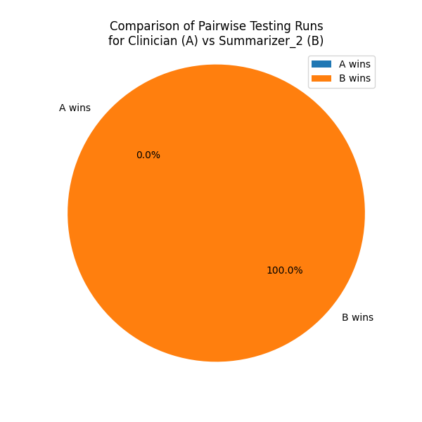
PAIRWISE COMPARISONS ACROSS 3 RUNS
Summarizer 2 (B) vs. Clinician (A):
Superior Completeness: Summarizer 2 included more relevant details from source records, capturing crucial historical context and providing comprehensive current information often omitted by A.
Higher Factual Accuracy: It offered a more precise reflection of dates and detailed information, avoiding the oversimplifications or contradictions found in A.
Better Chronological Order: B presented history in a clearer, more detailed sequence, often using helpful chronological lists or dated key events.
Superior Organization & Clarity: With a better-organized structure, Summarizer 2 utilized effective formatting for readability and logical structuring to facilitate quick review.
Greater Clinical Relevance: Combining accuracy and completeness, B was judged more useful, providing necessary depth and breadth for specialist understanding.

Slide 25
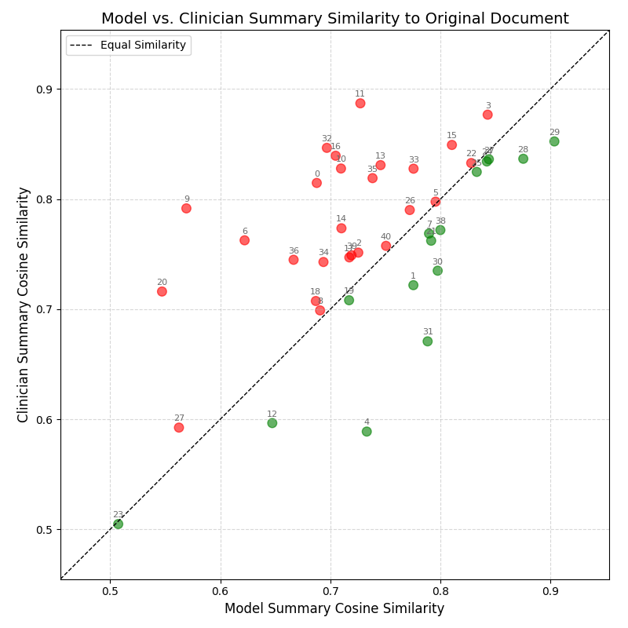
EMBEDDING SIMILARITIES TO PATIENT RECORDS

Slide 26
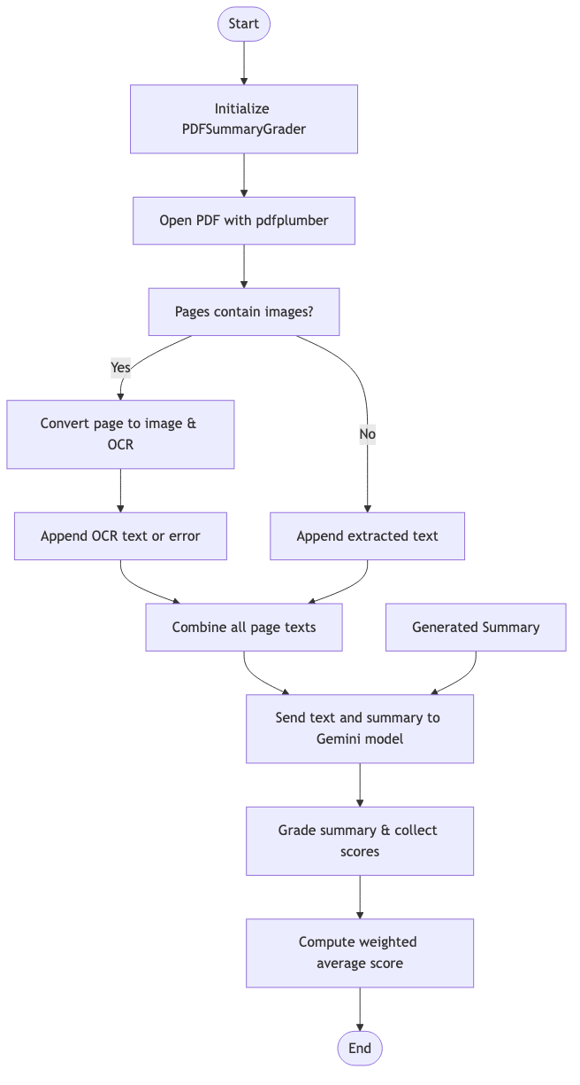
LLM GRADING FRAMEWORK DETAILS

Slide 27
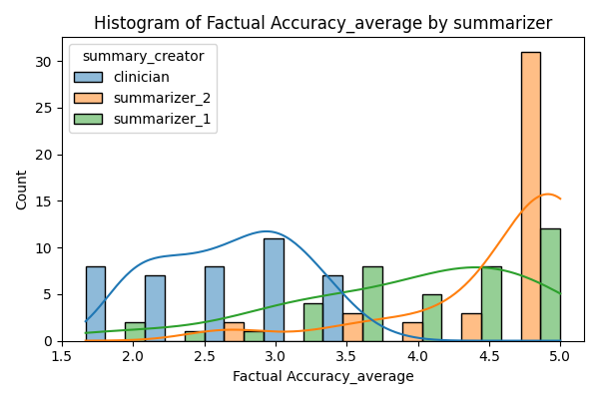
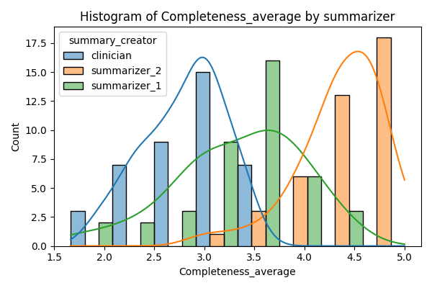
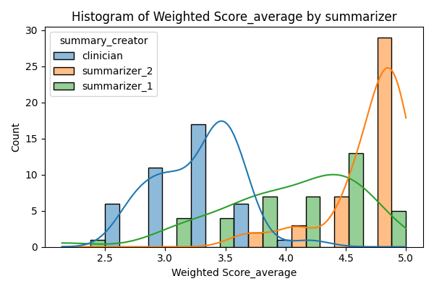
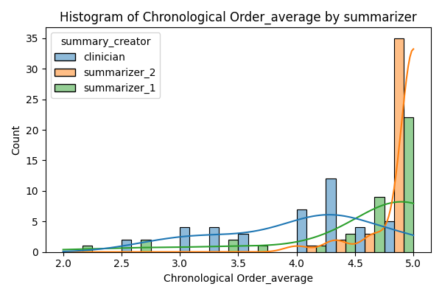
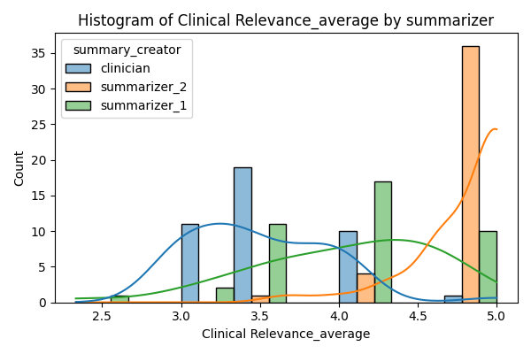
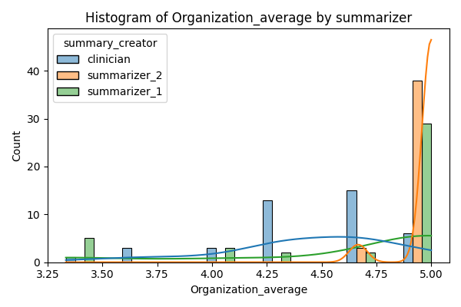
Histograms

Slide 28
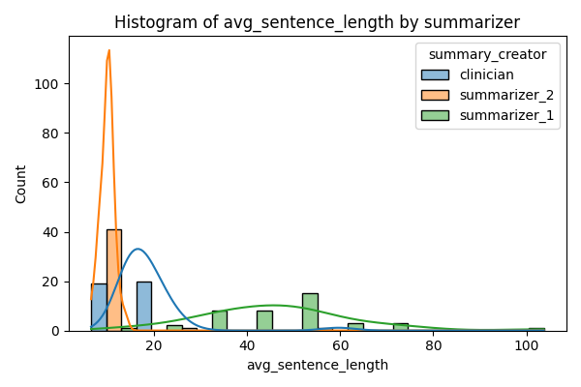
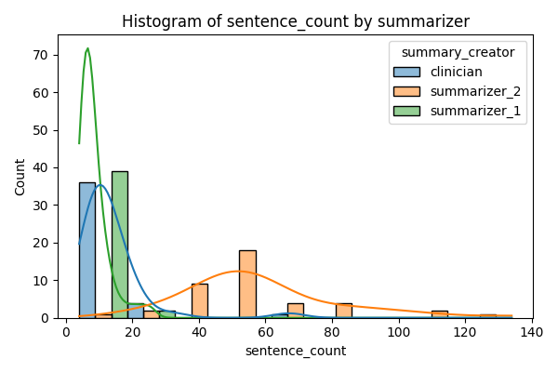
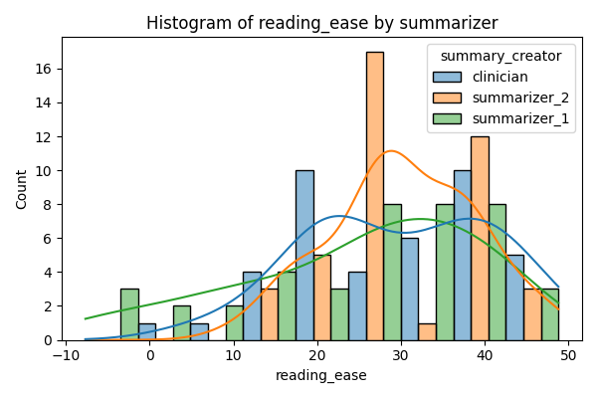
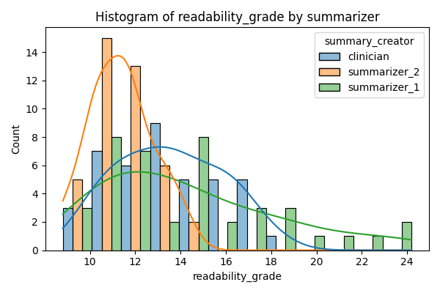
Histograms

